Slide 1

Libra Summer School and Workshop 2024
TSH: Part 1
Alexey Akimov
University at Buffalo, SUNY
July 9, 2024

Slide 2
Basic Concepts and Terminology of Nonadiabatic Dynamics

Slide 3
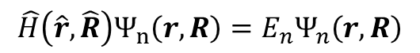
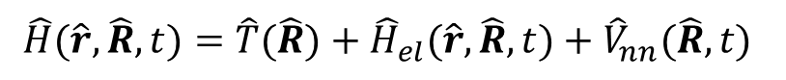
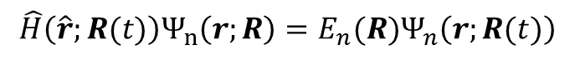
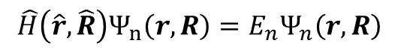
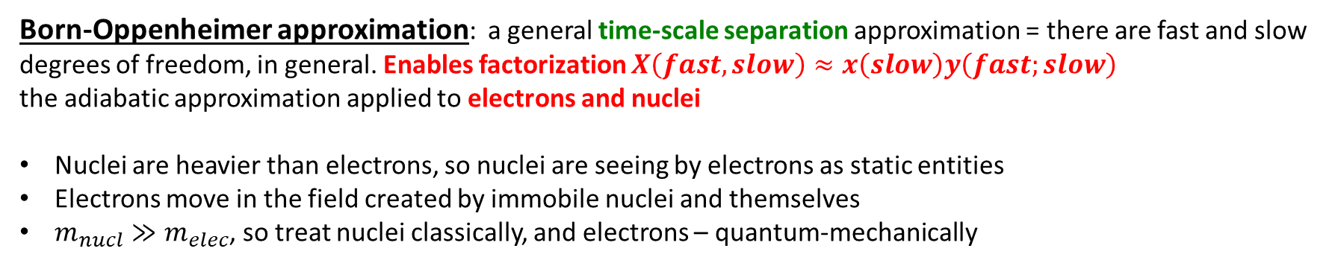
Born-Oppenheimer Approximation
$$\hat{H}(\hat{r},\hat{R},t)=\hat{T}(\hat{R})+{\hat{H}}_{el}(\hat{r},\hat{R},t)+{\hat{V}}_{nn}(\hat{R}, t)$$
$$\hat{H}\left(\hat{r},\hat{R}\right)Ψ_{n}\left(r,R\right)=E_{n}Ψ_{n}\left(r,R\right)$$
Includes el-el and el-nucl interactions
This is an electron-nuclear (vibronic) Hamiltonian
This is an electron-nuclear (vibronic) wavefunction
Born-Oppenheimer approximation: a general time-scale separation approximation = there are fast and slow degrees of freedom, in general. Enables factorization $X\left(fast, slow\right)≈x\left(slow\right)y\left(fast;slow\right)$
the adiabatic approximation applied to electrons and nuclei
Nuclei are heavier than electrons, so nuclei are seeing by electrons as static entities
Electrons move in the field created by immobile nuclei and themselves
$m_{nucl}≫m_{elec}$, so treat nuclei classically, and electrons – quantum-mechanically
$$\hat{H}\left(\hat{r},\hat{R}\right)Ψ_{n}\left(r,R\right)=E_{n}Ψ_{n}\left(r,R\right)$$
$$\hat{H}\left(\hat{r};R(t)\right)Ψ_{n}\left(r;R\right)=E_{n}(R)Ψ_{n}\left(r;R(t)\right)$$
BO approximation
Coordinates of nuclei are parameters
Energy – is a function of these parameters: potential energy surface
Coordinates of nuclei are the dynamical variables
Energy - is a number

Slide 4
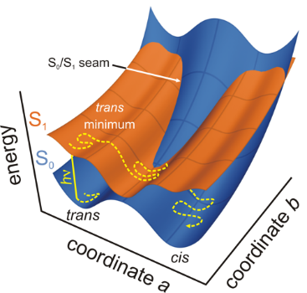
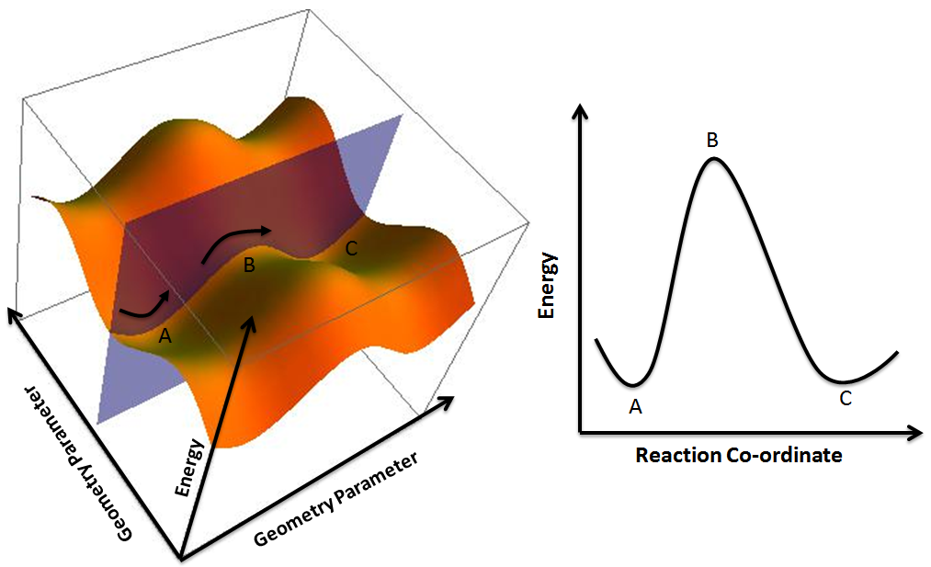
Potential energy surfaces (PES)
$$E_{n}\left(R\right)={\left\langle Ψ_{n}\left(r,R\right) | {\hat{H}}_{el}\left(r,R\right) | Ψ_{n}\left(r,R\right)\right\rangle }_{r}+V_{nn}(R)$$
Energy of a given state as a function of nuclear coordinates
Multidimensional, but one is often interested in lower-dimensional cuts (profiles)
Topology: minima, maxima, barriers, saddle points
Reaction coordinate – a collective transformation of all atoms
Present only as a consequence of the BO approximation
https://www.google.com/url?sa=i&url=https%3A%2F%2Fcommons.wikimedia.org%2Fwiki%2FFile%3APotential_Energy_Surface_and_Corresponding_Reaction_Coordinate_Diagram.png&psig=AOvVaw3JUnkD5y1MiNgWew9eCb6c&ust=1588191360500000&source=images&cd=vfe&ved=0CAIQjRxqFwoTCJj3nob4i-kCFQAAAAAdAAAAABAg
https://www.google.com/url?sa=i&url=http%3A%2F%2Fwwwuser.gwdg.de%2F~ggroenh%2Fresearch.html&psig=AOvVaw3JUnkD5y1MiNgWew9eCb6c&ust=1588191360500000&source=images&cd=vfe&ved=0CAIQjRxqFwoTCJj3nob4i-kCFQAAAAAdAAAAABAa

Slide 5
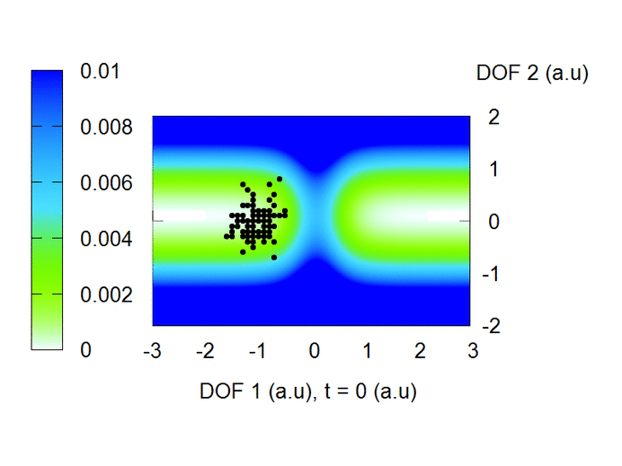
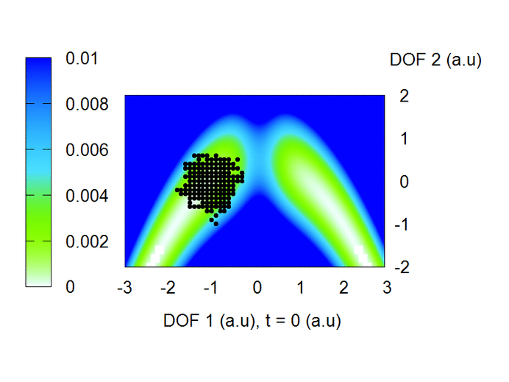
Potential energy surfaces define the reactive dynamics
Credit: Brendan Smith

Slide 6
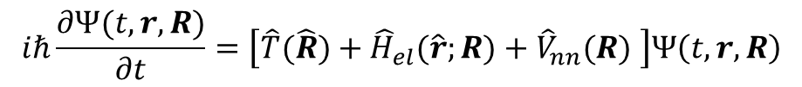
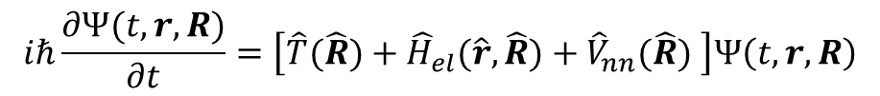
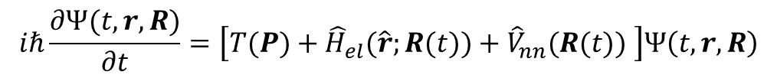
Tiers of approximation to the molecular Hamiltonian
Disregard the form of the wavefunction for now
Everything is operators!
Exact TD-SE
$$iℏ\frac{∂Ψ(t,r,R)}{∂t}=\left[\hat{T}(\hat{R})+{\hat{H}}_{el}(\hat{r},\hat{R})+{\hat{V}}_{nn}(\hat{R}) \right]Ψ\left(t, r,R\right)$$
Electronic DOFs are still operators (quantum)
$$iℏ\frac{∂Ψ(t,r,R)}{∂t}=\left[\hat{T}(\hat{R})+{\hat{H}}_{el}(\hat{r};R)+{\hat{V}}_{nn}(R) \right]Ψ\left(t, r,R\right)$$
TD-SE with the BO
Nuclear DOFs are variables – could be independent (quantum) or could be time-dependent (classical path)
In general, we still have nuclear kinetic energy operator (for quantum nuclei)
TD-SE with the classical path approximation (CPA)
$$iℏ\frac{∂Ψ(t,r, R)}{∂t}=\left[T(P)+{\hat{H}}_{el}(\hat{r};R(t))+{\hat{V}}_{nn}(R(t)) \right]Ψ\left(t, r,R\right)$$
Nuclear DOFs are time-dependent variables
Kinetic energy is a function of momentum

Slide 7
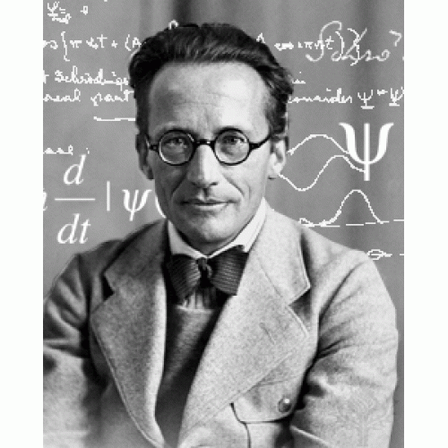
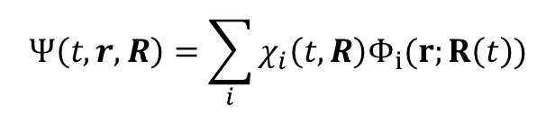
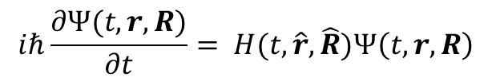
Adiabatic Approximation. Adiabatic and Nonadiabatic Dynamics
$$iℏ\frac{∂Ψ(t,r,R)}{∂t}= H(t,\hat{r},\hat{R})Ψ\left(t, r,R\right)$$
$$Ψ\left(t,r,R\right)=\sum_{i}{χ_{i}\left(t,R\right)Φ_{i}(r;R\left(t\right))}$$
Except for in the exact factorization ansatz!
Adiabatic approximation: keep only one term
1 term is sufficient
Need more than 1 state
Adiabatic Dynamics
Non-Adiabatic Dynamics
Where is the BO approximation?
Energy
Reaction coordinate

Slide 8
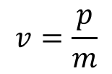
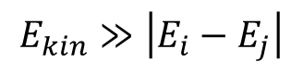
When NA dynamics is needed: Failure of the Born-Oppenheimer Approximation
light atoms (e.g. H – quantum nuclear effects)
high-energy (momentum) – e.g. colliding particles
degeneracies of quantum states (bond-breaking, plasmas, metals)
$$E_{kin}≫\left|E_{i}−E_{j}\right|$$
$$v=\frac{p}{m}$$
BO approximation is fine,
adiabatic regime
BO approximation is fine,
adiabatic regime
BO approximation breaks down here, non-adiabatic regime

Slide 9
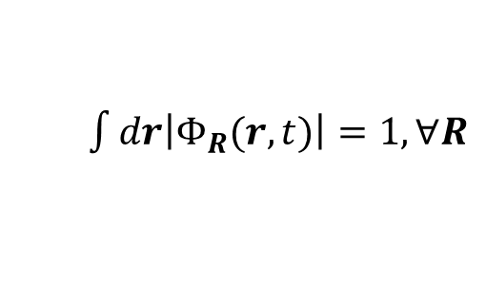
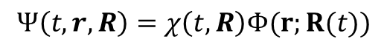
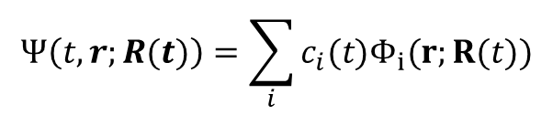
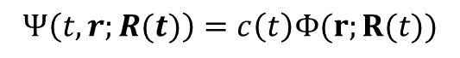
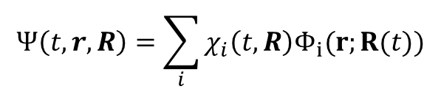
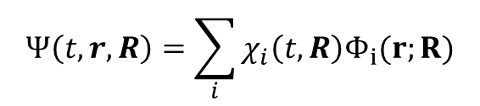
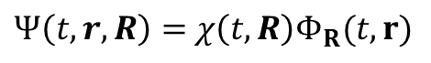
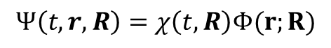
Tiers of approximations to the wavefunction
The solution largely depends on the approximation we make to represent the total wavefunction $Ψ(t,r,R)$
Nonadiabatic
Adiabatic
Exact factorization
$Ψ\left(t,r,R\right)=$ $χ\left(t,R\right)Φ_{R}(t,r)$
Agostini, F.; Curchod, B. F. E. WIREs Computational Molecular Science 2019, 9, e1417.
$\int{dr\left|Φ_{R}(r,t)\right|=1,}∀R$
Quantum nuclei, with BO approximation (AIMS, QTAG, etc.)
$$Ψ\left(t,r,R\right)=\sum_{i}{χ_{i}\left(t,R\right)Φ_{i}(r;R)}$$
$$Ψ\left(t,r,R\right)=χ\left(t,R\right)Φ(r;R)$$
Makhov, D. V.; Glover, W. J.; Martinez, T. J.; Shalashilin, D. V. J. Chem. Phys. 2014, 141, 054110.
Wavepacket-dressed trajectories
$$Ψ\left(t,r,R\right)=\sum_{i}{χ_{i}\left(t,R\right)Φ_{i}(r;R(t))}$$
Dutra, M.; Garashchuk, S.; Akimov, A. V. Int. J. Quantum Chem. 2023 e27078.
$$Ψ\left(t,r,R\right)=χ\left(t,R\right)Φ(r;R(t))$$
Bare trajectories
Tully, J. C. J. Chem. Phys. 1990, 93, 1061–1071.
$$Ψ\left(t,r;R(t)\right)=\sum_{i}{c_{i}(t)Φ_{i}(r;R(t))}$$
$$Ψ\left(t,r;R(t)\right)=c\left(t\right)Φ(r;R(t))$$

Slide 10
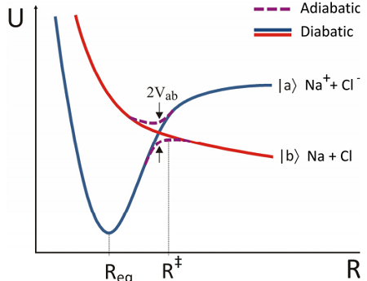
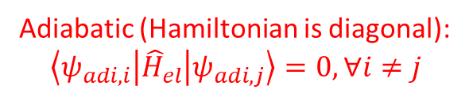
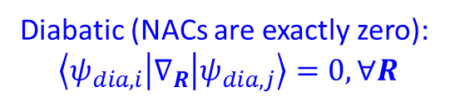
Terminology: Adiabatic and Diabatic States
Adiabatic
(Quasi-)Diabatic
unique
eigenstates of molecular Hamiltonian:
not always chemically-intuitive
non-unique, infinite # of possibilities
Is not an eigenstate of molecular Hamiltonian
usually chosen to be chemically-intuitive
Adiabatic (Hamiltonian is diagonal):
$$\left\langle ψ_{adi, i} | {\hat{H}}_{el} | ψ_{adi,j}\right\rangle =0, ∀i≠j$$
Diabatic (NACs are exactly zero):
$$\left\langle ψ_{dia,i} | ∇_{R} | ψ_{dia,j}\right\rangle =0, ∀R$$
https://chem.libretexts.org/Bookshelves/Physical_and_Theoretical_Chemistry_Textbook_Maps/Book%3A_Time_Dependent_Quantum_Mechanics_and_Spectroscopy_(Tokmakoff)/06%3A_Adiabatic_Approximation/6.03%3A_Diabatic_and_Adiabatic_States

Slide 11
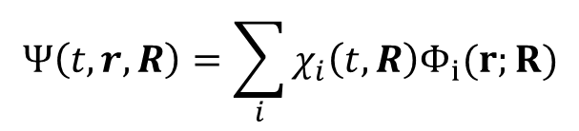
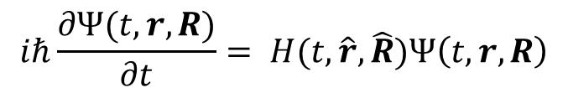
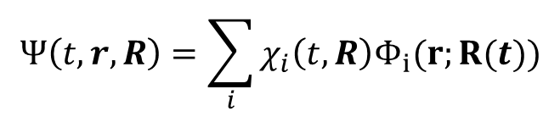
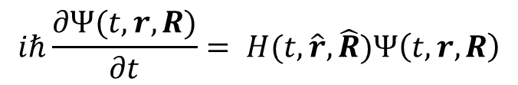
Examples of Deriving Equations of Motion with Different Approximations
Example 1: BO with quantum nuclei
Example 2: BO with wavepacket-dressed trajectories
$$iℏ\frac{∂Ψ(t,r,R)}{∂t}= H(t,\hat{r},\hat{R})Ψ\left(t, r,R\right)$$
$$iℏ\frac{∂Ψ(t,r,R)}{∂t}= H(t,\hat{r},\hat{R})Ψ\left(t, r,R\right)$$
$$Ψ\left(t,r,R\right)=\sum_{i}{χ_{i}\left(t,R\right)Φ_{i}(r;R)}$$
$$Ψ\left(t,r,R\right)=\sum_{i}{χ_{i}\left(t,R\right)Φ_{i}(r;R(t))}$$

Slide 12
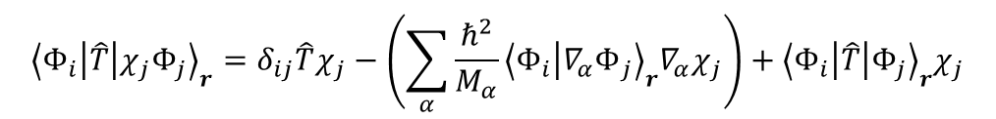
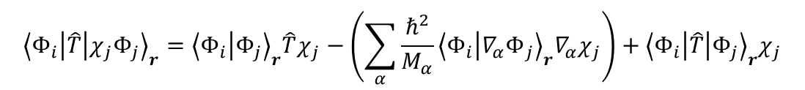

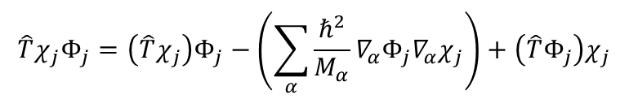

Case 1: Compute the action of $\hat{T}$ on $Ψ$
$$∇^{2}\left(AB\right)=∇\left(∇\left(AB\right)\right)=∇\left(\left(∇A\right)B+A∇B\right)=\left(∇^{2}A\right)B+2\left(∇A\right)\left(∇B\right)+A∇^{2}B$$
$$\left(\sum_{α}{−\frac{ℏ^{2}}{2M_{α}}∇_{α}^{2}}\right)χ_{j}Φ_{j}=\left(\sum_{α}{−\frac{ℏ^{2}}{2M_{α}}∇_{α}^{2}χ_{j}}\right)Φ_{j}−\left(2\sum_{α}{\frac{ℏ^{2}}{{2M}_{α}}∇_{α}Φ_{j}∇_{α}χ_{j}}\right)+\left(\sum_{α}{−\frac{ℏ^{2}}{2M_{α}}∇_{α}^{2}Φ_{j}}\right)χ_{j}$$
$$\hat{T}χ_{j}Φ_{j}=\left(\hat{T}χ_{j}\right)Φ_{j}−\left(\sum_{α}{\frac{ℏ^{2}}{M_{α}}∇_{α}Φ_{j}∇_{α}χ_{j}}\right)+\left(\hat{T}Φ_{j}\right)χ_{j}$$
We keep all terms, because $Φ$ is a function of $R$
Project on an arbitrary state $Φ_{i}$:
$${\left\langle Φ_{i} | \hat{T} | χ_{j}Φ_{j}\right\rangle }_{r}={\left\langle Φ_{i} | Φ_{j}\right\rangle }_{r}\hat{T}χ_{j}−\left(\sum_{α}{\frac{ℏ^{2}}{M_{α}}{\left\langle Φ_{i} | {∇_{α}Φ}_{j}\right\rangle }_{r}∇_{α}χ_{j}}\right)+{\left\langle Φ_{i} | \hat{T} | Φ_{j}\right\rangle }_{r}χ_{j}$$
$${\left\langle Φ_{i} | \hat{T} | χ_{j}Φ_{j}\right\rangle }_{r}=δ_{ij}\hat{T}χ_{j}−\left(\sum_{α}{\frac{ℏ^{2}}{M_{α}}{\left\langle Φ_{i} | {∇_{α}Φ}_{j}\right\rangle }_{r}∇_{α}χ_{j}}\right)+{\left\langle Φ_{i} | \hat{T} | Φ_{j}\right\rangle }_{r}χ_{j}$$
$${\left\langle Φ_{i} | {\hat{H}}_{nucl} | χ_{j}Φ_{j}\right\rangle }_{r}={\left\langle Φ_{i} | {\hat{H}}_{nucl} | Φ_{j}\right\rangle }_{r}χ_{j}={\left\langle Φ_{i} | E_{j}\left(R\right) | Φ_{j}\right\rangle }_{r}χ_{j}=E_{j}\left(R\right){\left\langle Φ_{i} | Φ_{j}\right\rangle }_{r}χ_{j}=E_{j}\left(R\right)δ_{ij}χ_{j}$$
$$\left\langle Φ_{i} | \hat{T}+{\hat{H}}_{nucl} | Ψ\right\rangle =\sum_{j}{{\left\langle Φ_{i} | \hat{T}+{\hat{H}}_{nucl} | χ_{j}Φ_{j}\right\rangle }_{r}}=\sum_{j}{\left[δ_{ij}\hat{T}χ_{j}−\left(\sum_{α}{\frac{ℏ^{2}}{M_{α}}{\left\langle Φ_{i} | {∇_{α}Φ}_{j}\right\rangle }_{r}∇_{α}χ_{j}}\right)+{\left\langle Φ_{i} | \hat{T} | Φ_{j}\right\rangle }_{r}χ_{j}+E_{j}\left(R\right)δ_{ij}\right]}$$

Slide 13
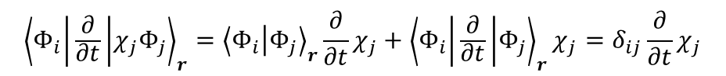
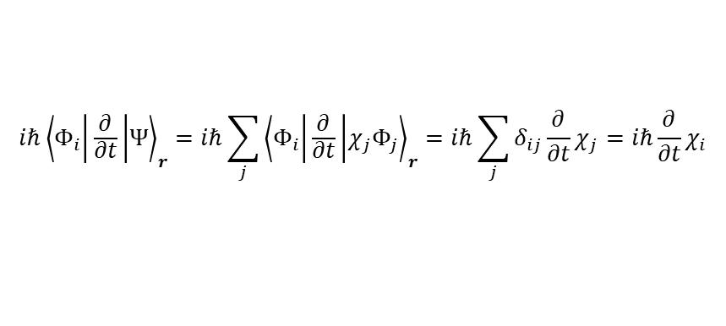
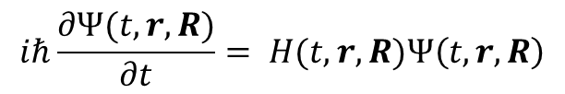
Compute the LHS: Case 1
$${\left\langle Φ_{i} | \frac{∂}{∂t} | χ_{j}Φ_{j}\right\rangle }_{r}={\left\langle Φ_{i} | Φ_{j}\right\rangle }_{r}\frac{∂}{∂t}χ_{j}+{\left\langle Φ_{i} | \frac{∂}{∂t} | Φ_{j}\right\rangle }_{r}χ_{j}=δ_{ij}\frac{∂}{∂t}χ_{j}$$
$$iℏ{\left\langle Φ_{i} | \frac{∂}{∂t} | Ψ\right\rangle }_{r}=iℏ\sum_{j}{{\left\langle Φ_{i} | \frac{∂}{∂t} | χ_{j}Φ_{j}\right\rangle }_{r}}=iℏ\sum_{j}{δ_{ij}\frac{∂}{∂t}χ_{j}}=iℏ\frac{∂}{∂t}χ_{i}$$
Now, combine the two parts of the equation:
$$iℏ\frac{∂Ψ(t,r,R)}{∂t}= H(t,r,R)Ψ\left(t, r,R\right)$$
$$iℏ\frac{∂}{∂t}χ_{i}=\left[\hat{T}+E_{i}\left(R\right)+\left\langle Φ_{i} | \hat{T} | Φ_{i}\right\rangle \right]χ_{i}−\sum_{j,α}{\frac{ℏ^{2}}{M_{α}}\left\langle Φ_{i} | {∇_{α}Φ}_{j}\right\rangle ∇_{α}χ_{j}}−\sum_{j≠i,α}{\frac{ℏ^{2}}{2M_{α}}\left\langle Φ_{i} | {∇_{α}^{2}Φ}_{j}\right\rangle χ_{j}}$$
$$iℏ\frac{∂}{∂t}χ_{i}=\left[\hat{T}+E_{i}\left(R\right)+\left\langle Φ_{i} | \hat{T} | Φ_{i}\right\rangle \right]χ_{i}−iℏ\sum_{j,α}{\left\langle Φ_{i} | {∇_{α}Φ}_{j}\right\rangle \frac{\left(−iℏ∇_{α}\right)χ_{j}}{M_{α}}}−\sum_{j≠i,α}{\frac{ℏ^{2}}{2M_{α}}\left\langle Φ_{i} | {∇_{α}^{2}Φ}_{j}\right\rangle χ_{j}}$$
$$iℏ\frac{∂}{∂t}χ_{i}=\left[\hat{T}+E_{i}\left(R\right)+\left\langle Φ_{i} | \hat{T} | Φ_{i}\right\rangle \right]χ_{i}−iℏ\sum_{j,α}{\left\langle Φ_{i} | {∇_{α}Φ}_{j}\right\rangle \frac{{\hat{p}}_{α}χ_{j}}{M_{α}}}−\sum_{j≠i,α}{\frac{ℏ^{2}}{2M_{α}}\left\langle Φ_{i} | {∇_{α}^{2}Φ}_{j}\right\rangle χ_{j}}$$

Slide 14

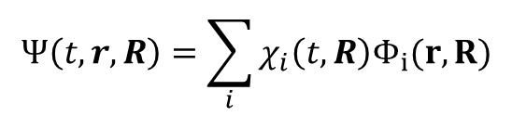
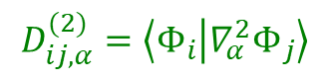
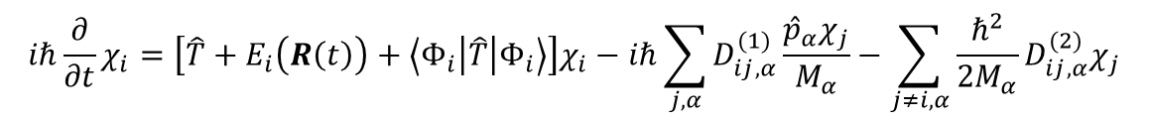
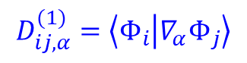
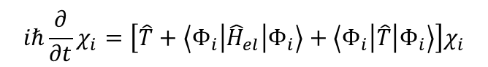
Nonadiabatic dynamics
This is what defines the evolution of nuclear component of the wavefunction and populations of all electronic states.
$$Ψ\left(t,r,R\right)=\sum_{i}{χ_{i}\left(t,R\right)Φ_{i}(r,R)}$$
Diagonal BO correction to the PES!
(ZPE of electrons)
In the adiabatic basis
$$iℏ\frac{∂}{∂t}χ_{i}=\left[\hat{T}+E_{i}\left(R\left(t\right)\right)+\left\langle Φ_{i} | \hat{T} | Φ_{i}\right\rangle \right]χ_{i}−iℏ\sum_{j,α}{D_{ij,α}^{(1)}\frac{{\hat{p}}_{α}χ_{j}}{M_{α}}}−\sum_{j≠i,α}{\frac{ℏ^{2}}{2M_{α}}D_{ij,α}^{(2)}χ_{j}}$$
$$D_{ij,α}^{(1)}=\left\langle Φ_{i} | {∇_{α}Φ}_{j}\right\rangle$$
first-order nonadiabatic couplings (NAC) - vector
Describes how a nuclear DOF $α$ couples electronic state $i$ and $j$
This is what determines the rates of nonadiabatic transitions.
$$D_{ij,α}^{(2)}=\left\langle Φ_{i} | {∇_{α}^{2}Φ}_{j}\right\rangle$$
second-order NAC - scalar
$$iℏ\frac{∂}{∂t}χ_{i}=\left[\hat{T}+\left\langle Φ_{i} | {\hat{H}}_{el} | Φ_{i}\right\rangle +\left\langle Φ_{i} | \hat{T} | Φ_{i}\right\rangle \right]χ_{i}$$
In the diabatic basis
Nuclear dynamics on state i is defined by the probability density: $P_{i}\left(t,R\right)={\left|{\left\langle Φ_{i} | Ψ\right\rangle }_{r}\right|}^{2}={\left|χ_{i}(t,R)\right|}^{2}$
Population of a state $i$: $P_{i}\left(t\right)={\left|{\left\langle Φ_{i} | Ψ\right\rangle }_{r,R}\right|}^{2}={\left|χ_{i}(t)\right|}^{2}$

Slide 15
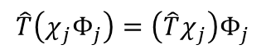
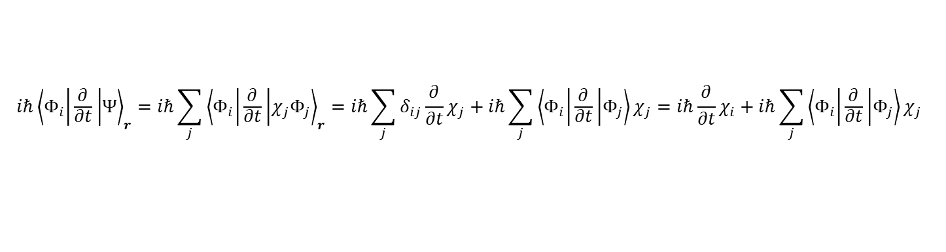

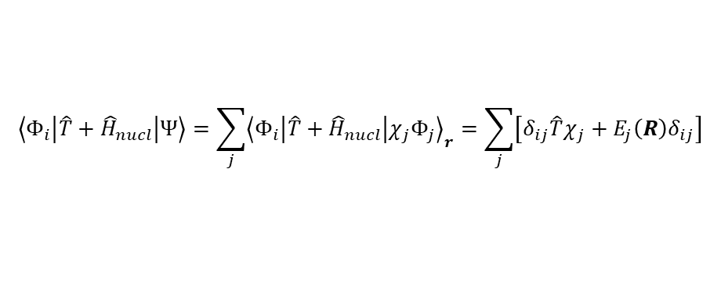

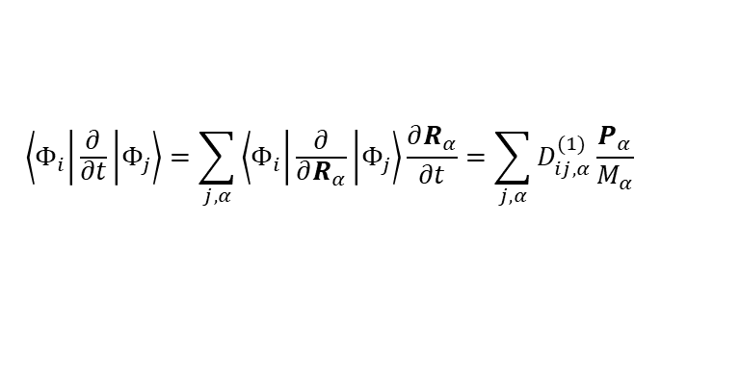
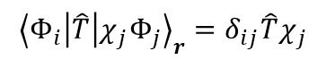
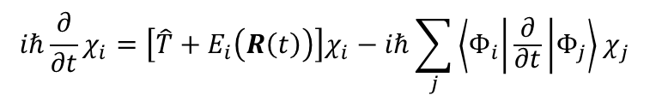
Case 2: Compute the action of $\hat{T}$ on $Ψ$
$$\left(\sum_{α}{−\frac{ℏ^{2}}{2M_{α}}∇_{α}^{2}}\right)χ_{j}Φ_{j}=\left(\sum_{α}{−\frac{ℏ^{2}}{2M_{α}}∇_{α}^{2}χ_{j}}\right)Φ_{j}−\left(2\sum_{α}{\frac{ℏ^{2}}{{2M}_{α}}∇_{α}Φ_{j}∇_{α}χ_{j}}\right)+\left(\sum_{α}{−\frac{ℏ^{2}}{2M_{α}}∇_{α}^{2}Φ_{j}}\right)χ_{j}$$
$$\hat{T}\left(χ_{j}Φ_{j}\right)=\left(\hat{T}χ_{j}\right)Φ_{j}$$
because $Φ$ is only a function of time, not $R$
$${\left\langle Φ_{i} | \hat{T} | χ_{j}Φ_{j}\right\rangle }_{r}=δ_{ij}\hat{T}χ_{j}$$
$$\left\langle Φ_{i} | \hat{T}+{\hat{H}}_{nucl} | Ψ\right\rangle =\sum_{j}{{\left\langle Φ_{i} | \hat{T}+{\hat{H}}_{nucl} | χ_{j}Φ_{j}\right\rangle }_{r}}=\sum_{j}{\left[δ_{ij}\hat{T}χ_{j}+E_{j}\left(R\right)δ_{ij}\right]}$$
$$\left\langle Φ_{i} | \frac{∂}{∂t} | χ_{j}Φ_{j}\right\rangle ={\left\langle Φ_{i} | Φ_{j}\right\rangle }_{r}\frac{∂}{∂t}χ_{j}+\left\langle Φ_{i} | \frac{∂}{∂t} | Φ_{j}\right\rangle χ_{j}=δ_{ij}\frac{∂}{∂t}χ_{j}+\left\langle Φ_{i} | \frac{∂}{∂t} | Φ_{j}\right\rangle χ_{j}$$
Compute the LHS
$$iℏ{\left\langle Φ_{i} | \frac{∂}{∂t} | Ψ\right\rangle }_{r}=iℏ\sum_{j}{{\left\langle Φ_{i} | \frac{∂}{∂t} | χ_{j}Φ_{j}\right\rangle }_{r}}=iℏ\sum_{j}{δ_{ij}\frac{∂}{∂t}χ_{j}}+iℏ\sum_{j}{\left\langle Φ_{i} | \frac{∂}{∂t} | Φ_{j}\right\rangle χ_{j}}=iℏ\frac{∂}{∂t}χ_{i}+iℏ\sum_{j}{\left\langle Φ_{i} | \frac{∂}{∂t} | Φ_{j}\right\rangle χ_{j}}$$
$$iℏ\frac{∂}{∂t}χ_{i}=\left[\hat{T}+E_{i}\left(R\left(t\right)\right)\right]χ_{i}−iℏ\sum_{j}{\left\langle Φ_{i} | \frac{∂}{∂t} | Φ_{j}\right\rangle χ_{j}}$$
$$\left\langle Φ_{i} | \frac{∂}{∂t} | Φ_{j}\right\rangle =\sum_{j,α}{\left\langle Φ_{i} | \frac{∂}{∂R_{α}} | Φ_{j}\right\rangle \frac{∂R_{α}}{∂t}}=\sum_{j,α}{D_{ij,α}^{(1)}\frac{P_{α}}{M_{α}}}$$
This terms appears because $Φ$ is an implicit function of time, via $R(t)$

Slide 16
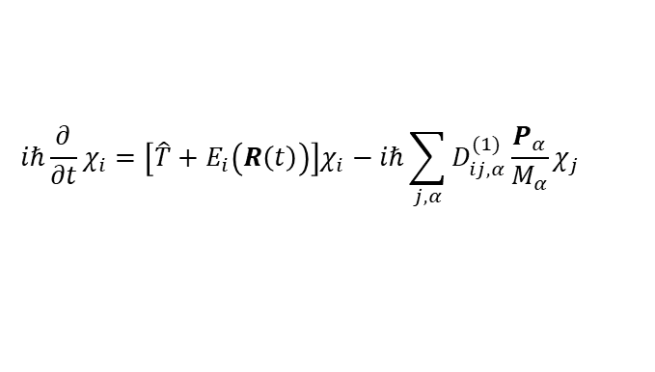









Summary
Example 1: BO with quantum nuclei
Example 2: BO with wavepacket-dressed trajectories
$$Ψ\left(t,r,R\right)=\sum_{i}{χ_{i}\left(t,R\right)Φ_{i}(r;R)}$$
$$Ψ\left(t,r,R\right)=\sum_{i}{χ_{i}\left(t,R\right)Φ_{i}(r;R(t))}$$
Nonadiabatic, adiabatic basis
$$iℏ\frac{∂}{∂t}χ_{i}=\left[\hat{T}+E_{i}\left(R\left(t\right)\right)+\left\langle Φ_{i} | \hat{T} | Φ_{i}\right\rangle \right]χ_{i}−iℏ\sum_{j,α}{D_{ij,α}^{(1)}\frac{{\hat{p}}_{α}χ_{j}}{M_{α}}}−\sum_{j≠i,α}{\frac{ℏ^{2}}{2M_{α}}D_{ij,α}^{(2)}χ_{j}}$$
$$iℏ\frac{∂}{∂t}χ_{i}=\left[\hat{T}+E_{i}\left(R\left(t\right)\right)\right]χ_{i}−iℏ\sum_{j,α}{D_{ij,α}^{(1)}\frac{P_{α}}{M_{α}}χ_{j}}$$
$$iℏ\frac{∂}{∂t}χ_{i}=\left[\hat{T}+\left\langle Φ_{i} | {\hat{H}}_{el} | Φ_{i}\right\rangle +\left\langle Φ_{i} | \hat{T} | Φ_{i}\right\rangle \right]χ_{i}$$
$$iℏ\frac{∂}{∂t}χ_{i}=\left[\hat{T}+\left\langle Φ_{i} | {\hat{H}}_{el} | Φ_{i}\right\rangle \right]χ_{i}$$
Nonadiabatic, diabatic basis
$$iℏ\frac{∂}{∂t}χ=\left[\hat{T}+E_{i}\left(R\left(t\right)\right)+\left\langle Φ_{i} | \hat{T} | Φ_{i}\right\rangle \right]χ$$
$$iℏ\frac{∂}{∂t}χ=\left[\hat{T}+E_{i}\left(R\left(t\right)\right)\right]χ$$
Adiabatic, adiabatic basis
$$iℏ\frac{∂}{∂t}χ=\left[\hat{T}+\left\langle Φ_{i} | {\hat{H}}_{el} | Φ_{i}\right\rangle +\left\langle Φ_{i} | \hat{T} | Φ_{i}\right\rangle \right]χ$$
Adiabatic, diabatic basis
$$iℏ\frac{∂}{∂t}χ=\left[\hat{T}+\left\langle Φ_{i} | {\hat{H}}_{el} | Φ_{i}\right\rangle \right]χ$$

